Slide 1

ZAHEER EBBRAHIM 216001758
Computer Science 3A – Mini Practical
Sustainable Development Goal 3
ICE – In Case of Emergency

Slide 2

UNITED NATIONS SDG

Slide 3
PROBLEM
Even though we live in a world where space travel is possible, our world still cannot provide quality health care to every single person regardless of age or financial standing.
According to a recent worldwide study some 20% of the worlds population live an hour away from a hospital. From a patients point of view that often results in them not coming where possible hospitals are for the.
Organ donation is a critical problem in this world. According to a study, 20 people die every day waiting for a transplant as well as 10% of all organs die on transportation

Slide 4
SOLUTION
Ice tries to solve these problems from both the Hospital and Doctors side as well as the Patients side
ICE allows a hospital to find the quickest route to another hospital for an organ donation as well as providing both a flght/car travel time estimate and according to the 4 hour organ-transplant-rule, will the organ still be viable at the end. This system can also help hospitals to find the nearest hospital to transfer a patient/doctor to.
ICE allows patients to quickly find routes to the nearest hospitals around them as well as see what hospitals are close to them this helps to inform patients of potential health care.

Slide 5


Slide 6
PROGRAM OVERVEW
A Hospital representative or patient will register for the program and log in to the ICE SERVER.
After this they can find a route from their current hospital location, filtered by provinces to a predetermined hospital. The system will find the closest route and display a GPS like reading of how they will get there as well as distances and times.
The user can also read information about a multitude of diseases as well as delete and add new diseases or hospital locations.

Slide 7
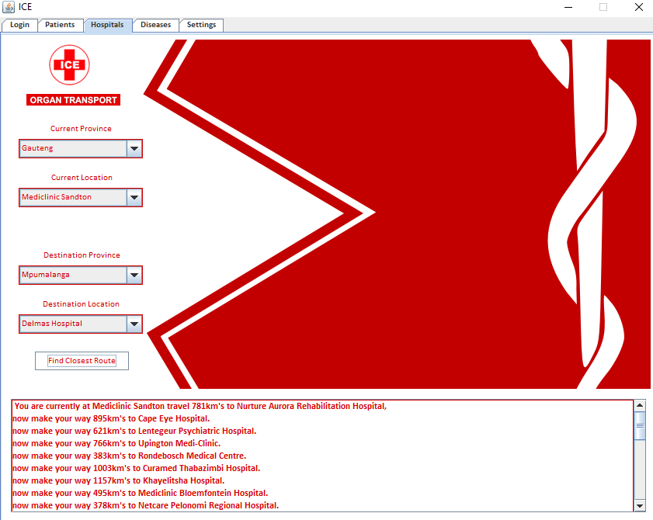

Slide 8
ADVANTAGES OF ICE
ICE SAVES LIVES and is free to use.
ICE allows quick and easy filtration and selection of Start and Destination location as well as provides quick disease retrieval and deletion
ICE provides an intuitive way to find the closest way to a hospital as well as estimated times for both air and car travel including organ viability and distances.
ICE will improve the amount of people that seek health care as well as the denial rate of a non viable organ transplant.

Slide 9
DISADVANTAGES OF ICE
ICE cannot account for traffic / special circumstances.
ICE only has a selection of the 70 most popular hospitals in South Africa and not the entire world.
ICE does not allow for mobility with a mobile app .

Slide 10
CONCLUSION
Although ICE cannot single handily provide healthy lives and well being to the entire world, ICE can help to positively impact the lives of people
As we say at ICE – “We are all about saving lives”

Slide 11


